Slide 1
Brain POP
32112191 kim min hwan
32112194 Kim hyo sang
32112215 choi ji soo

Slide 2
context
Embedding Design
Game information(video clip)
Game simulation(video clip)
Class diagrame

Slide 3
Embedding Design_1 Embedding Design_2

Slide 4
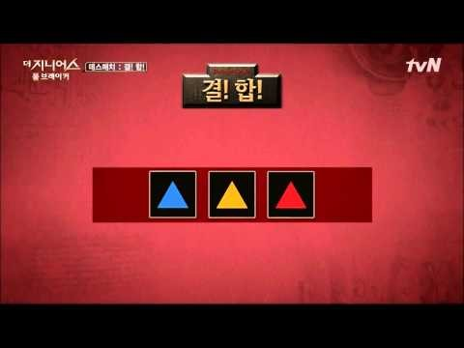
Game information(결 합)

Slide 5
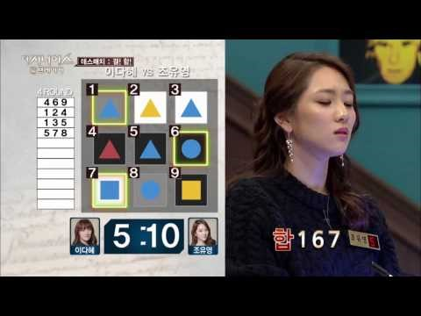
Game simulation(결 합)

Slide 6
Class diagram

Slide 7
Thank you!!

